Slide 1
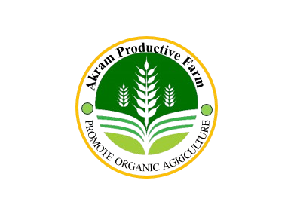

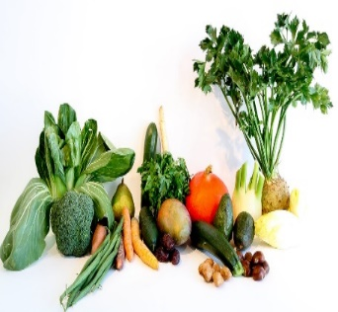
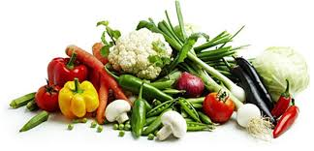

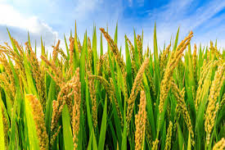
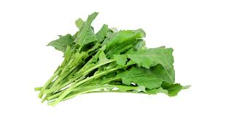
Akram Productive Farm PROMOTE ORGANIC AGRICULTURE
Name: F M Akramul
Roll: 01-022-02
Batch: 022
Dept.: Soil and Environmenta Sciences
Date: 06 Oct 2024

Slide 2
Introduction: Akram Productive Farm is a prominent agricultural enterprise located in Khulna; Bangladesh. Specializing in the cultivation of essential crops such as rice, potatoes, wheat, vegetables, and fruits, the farm plays a crucial role in meeting the local demand for these staples. The other farm including Cattle farm with Cow and Goat. By ensuring a steady supply of high-quality produce, Akram productive Farm not only supports the dietary needs of the local population but also contributes significantly to the economic stability and growth of the region. Major Products of Farming Dairy farming Goat farming Vegetation Fruits Organic Fertilizer

Slide 3
Project Farmland Distribution
Production | Total Land
Cattle | 5%
Grass | 25%
Rice | 30%
Wheat | 10%
Potatoes | 5%
Vegetables | 15%
Fruits | 10%

Slide 4
Production of Different Organic Agricultural Products
Rice Wheat Potato
Vegetation
Banana Mango Orange
Fruits
Cow Goat
Cattle
Organic Fertilizer
Organic Products

Slide 5
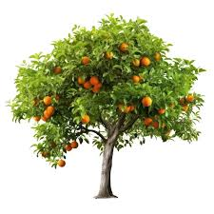
Statistically Description of these Farm
Product name | Total cost | Total sell | Profit
Cattle | 243700 | 305655 | 61955
Grass | 644343 | 750000 | 105657
Rice | 124433 | 233476 | 109043
Wheat | 23455 | 54666 | 31211
Potatoes | 23455 | 45000 | 21545
Vegetables | 34225 | 66000 | 31775
Fruits | 1234 | 50000 | 48766

Slide 6

Organic Farm Description

Slide 7
Conclusion:
Akram Productive Farm significantly contributes to the local economy and food security in Khulna, Bangladesh, by producing a variety of essential crops. Here's a detailed look at its contributions as staple foods in Bangladesh, the production of rice and wheat by Akram Productive Farm helps to meet the daily dietary needs of the local population. This reduces dependency on imports and stabilizes local food prices. These are crucial for a balanced diet, providing essential nutrients. The farm's production ensures a steady supply of fresh produce, enhancing the nutritional intake of the community.

Slide 8
Thank You Everyone

